Slide 1


BIG DATA VISUALS - ENGAGING STAKEHOLDERS FOR TORONTO FC
Welcome! We're excited to explore Toronto FC fan behavior to help improve the fan experience.

Slide 2
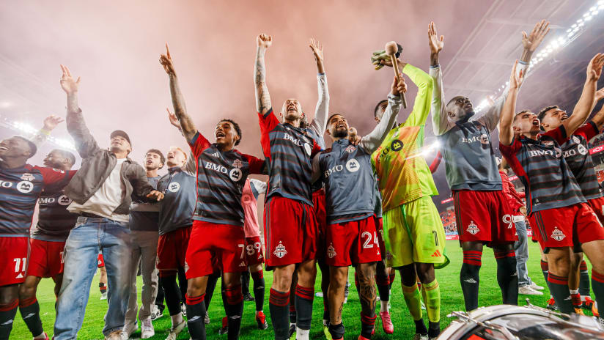
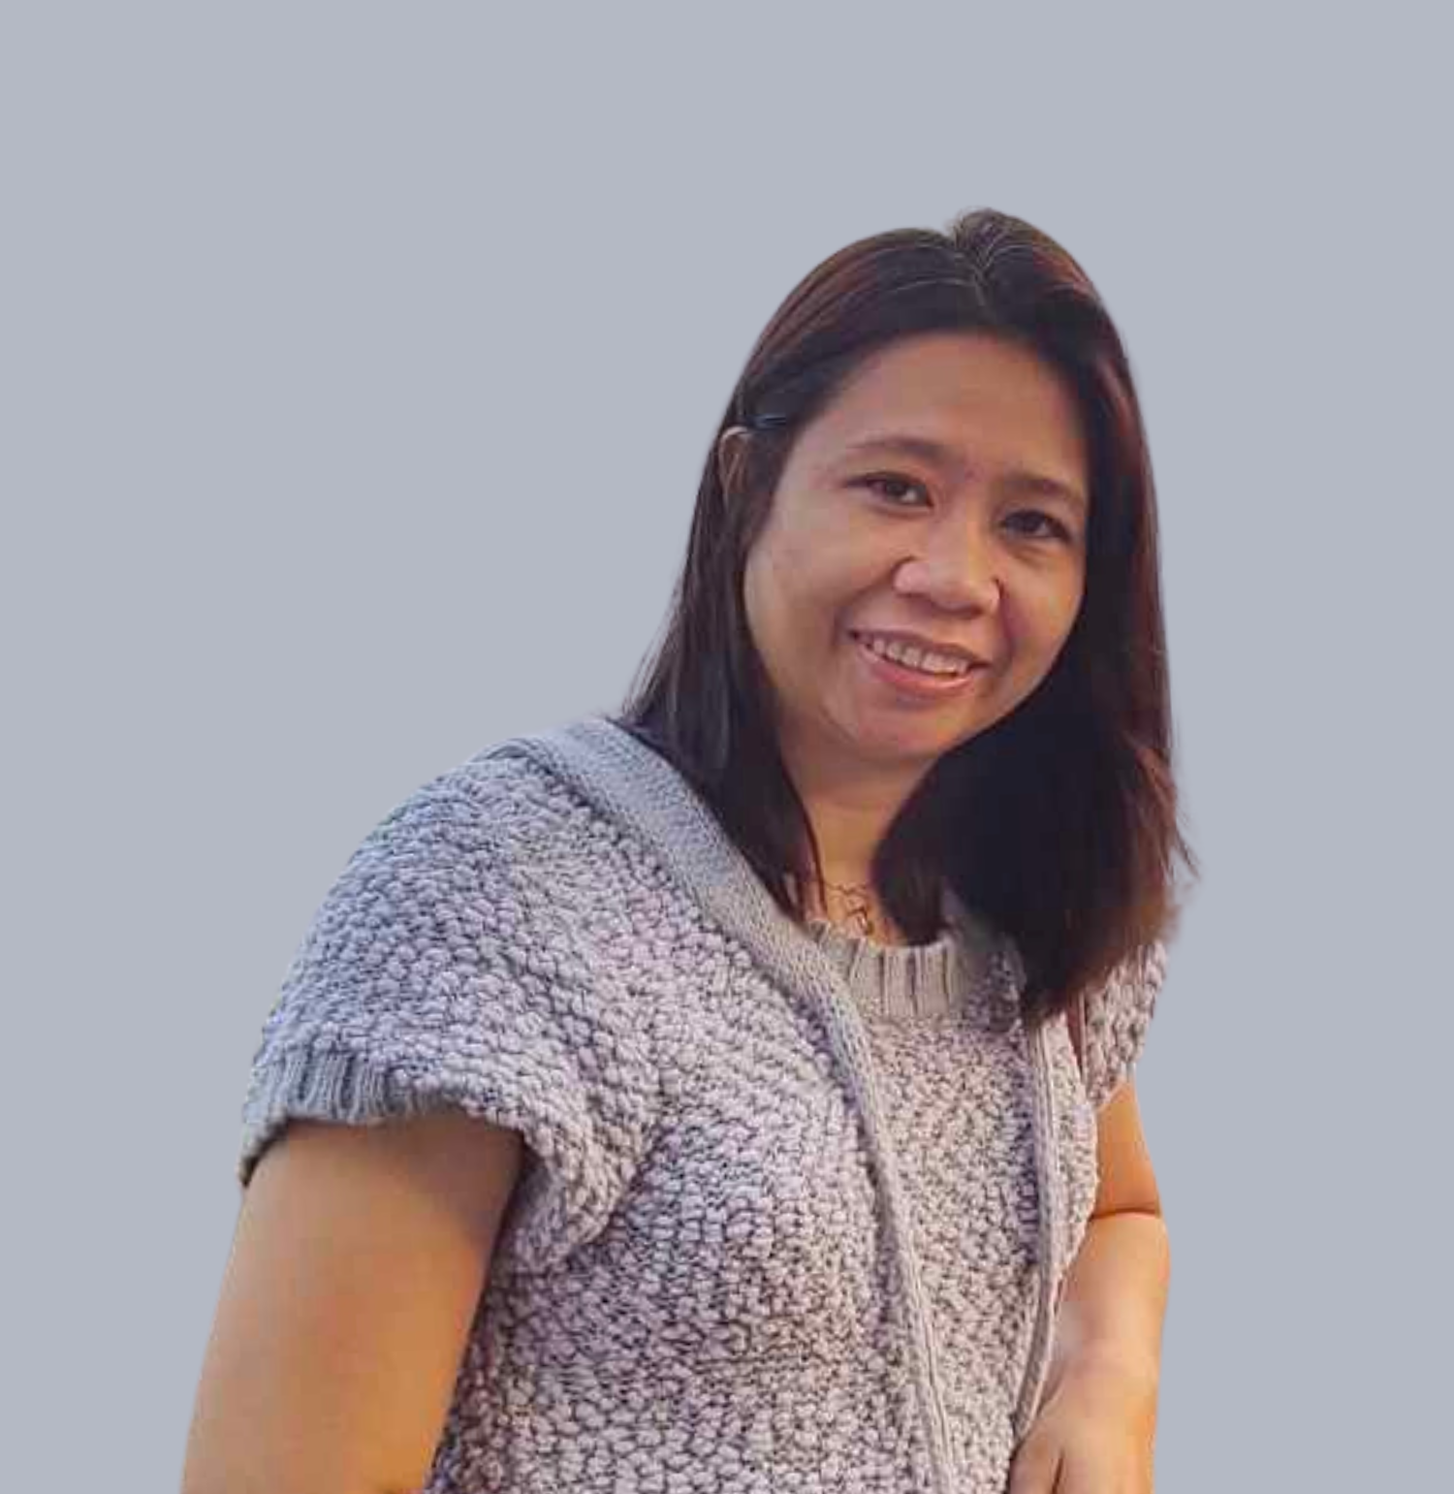

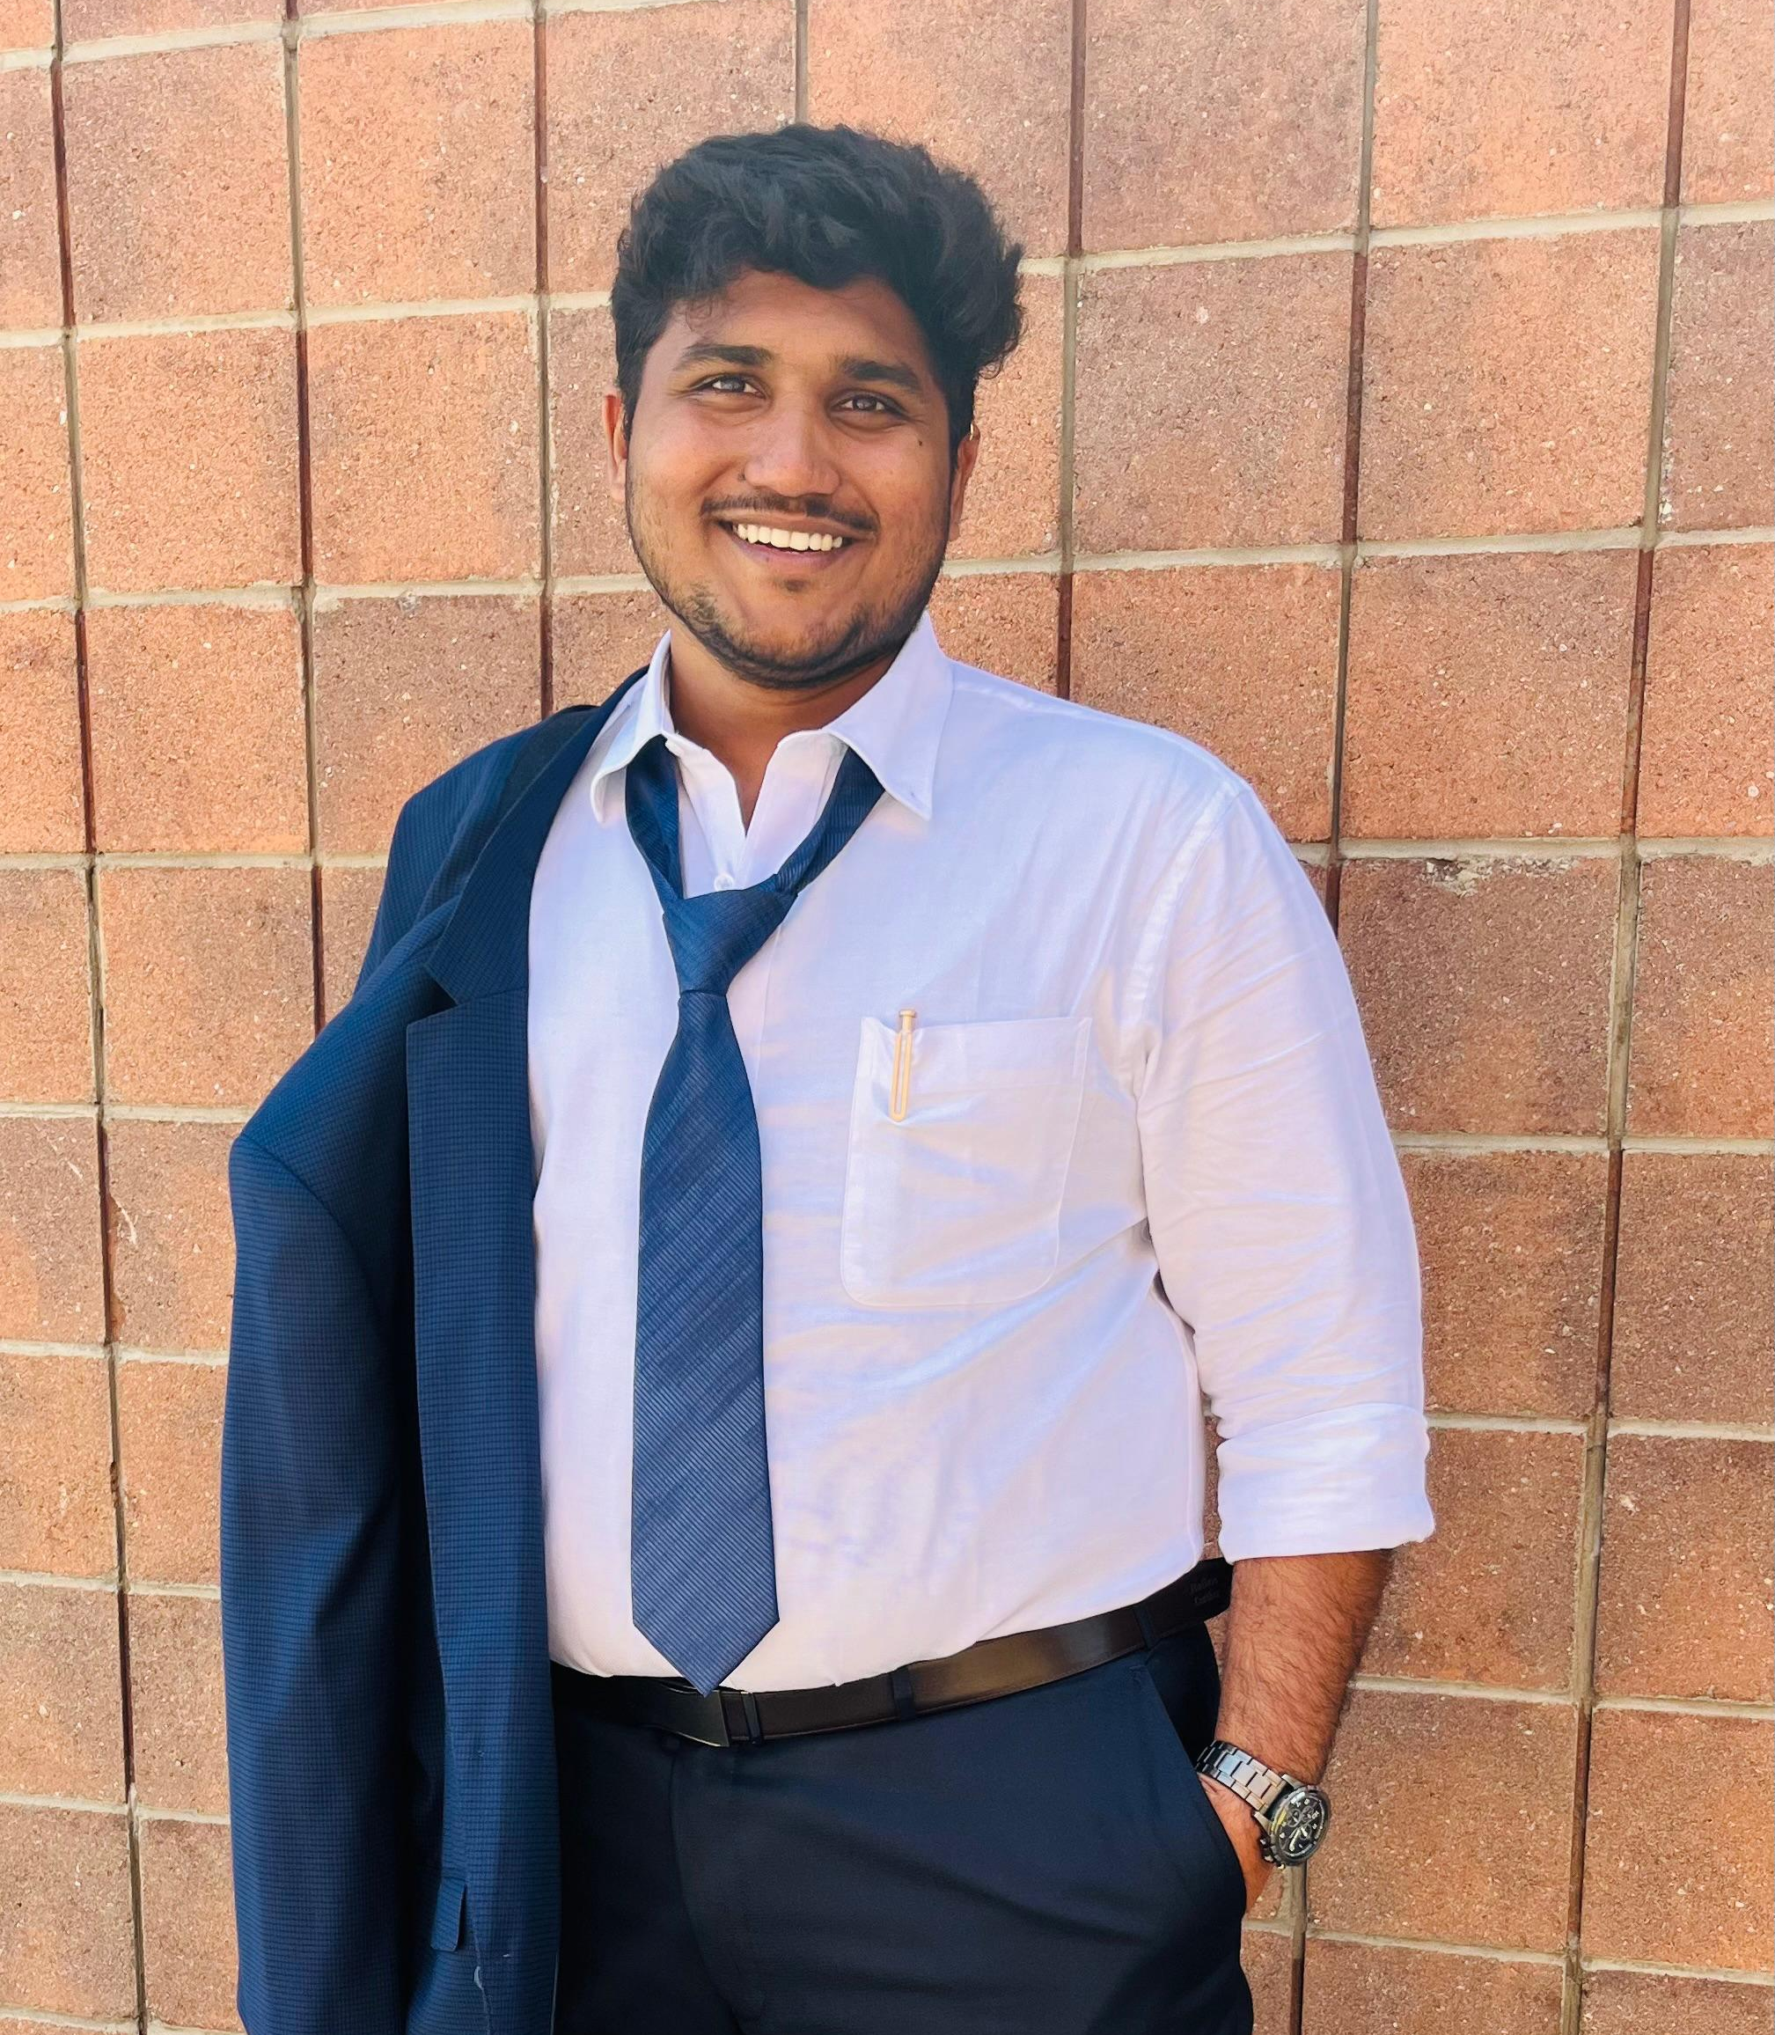
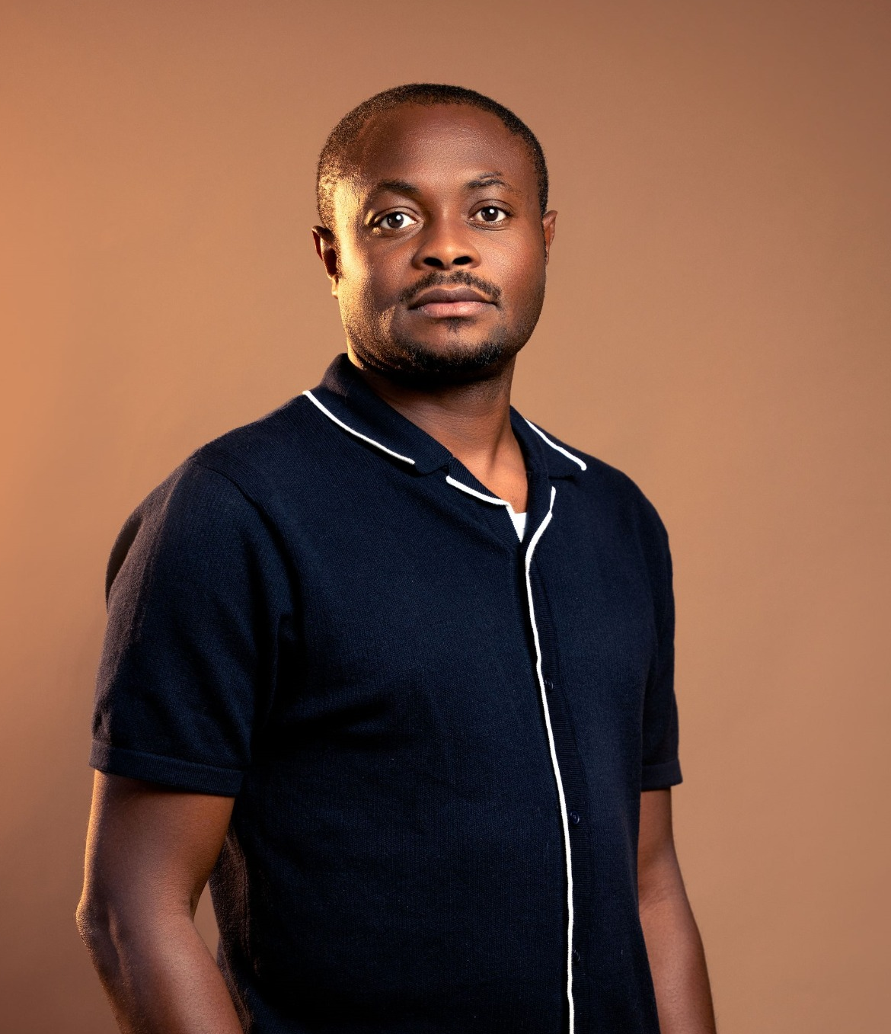

TEAM MEMBERS
Prescila Mora
Mohamed Afthab
Venkata Manish
Chibuike Okoroama

Slide 3
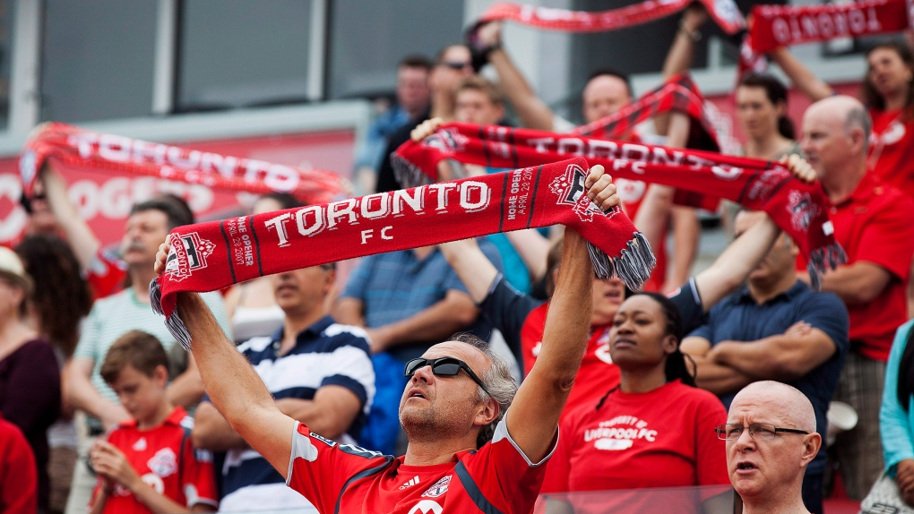
CLIENT
Name : Toronto FC (Football Club)
Location : Bay St. Toronto, Ontario
Phone : (416) - 360 - 4625
Team Worth : $ 690 M
Fan Base : Red Boys
Home Stadium : BMO Field, Toronto
Stadium Capacity : 30000+
League : Major League Soccer

Slide 4
AGENDA
Recap & Overview
Team Structure & Roles
Data Analysis
Visualization & Insights
Strategies for Stake holders
References

Slide 5
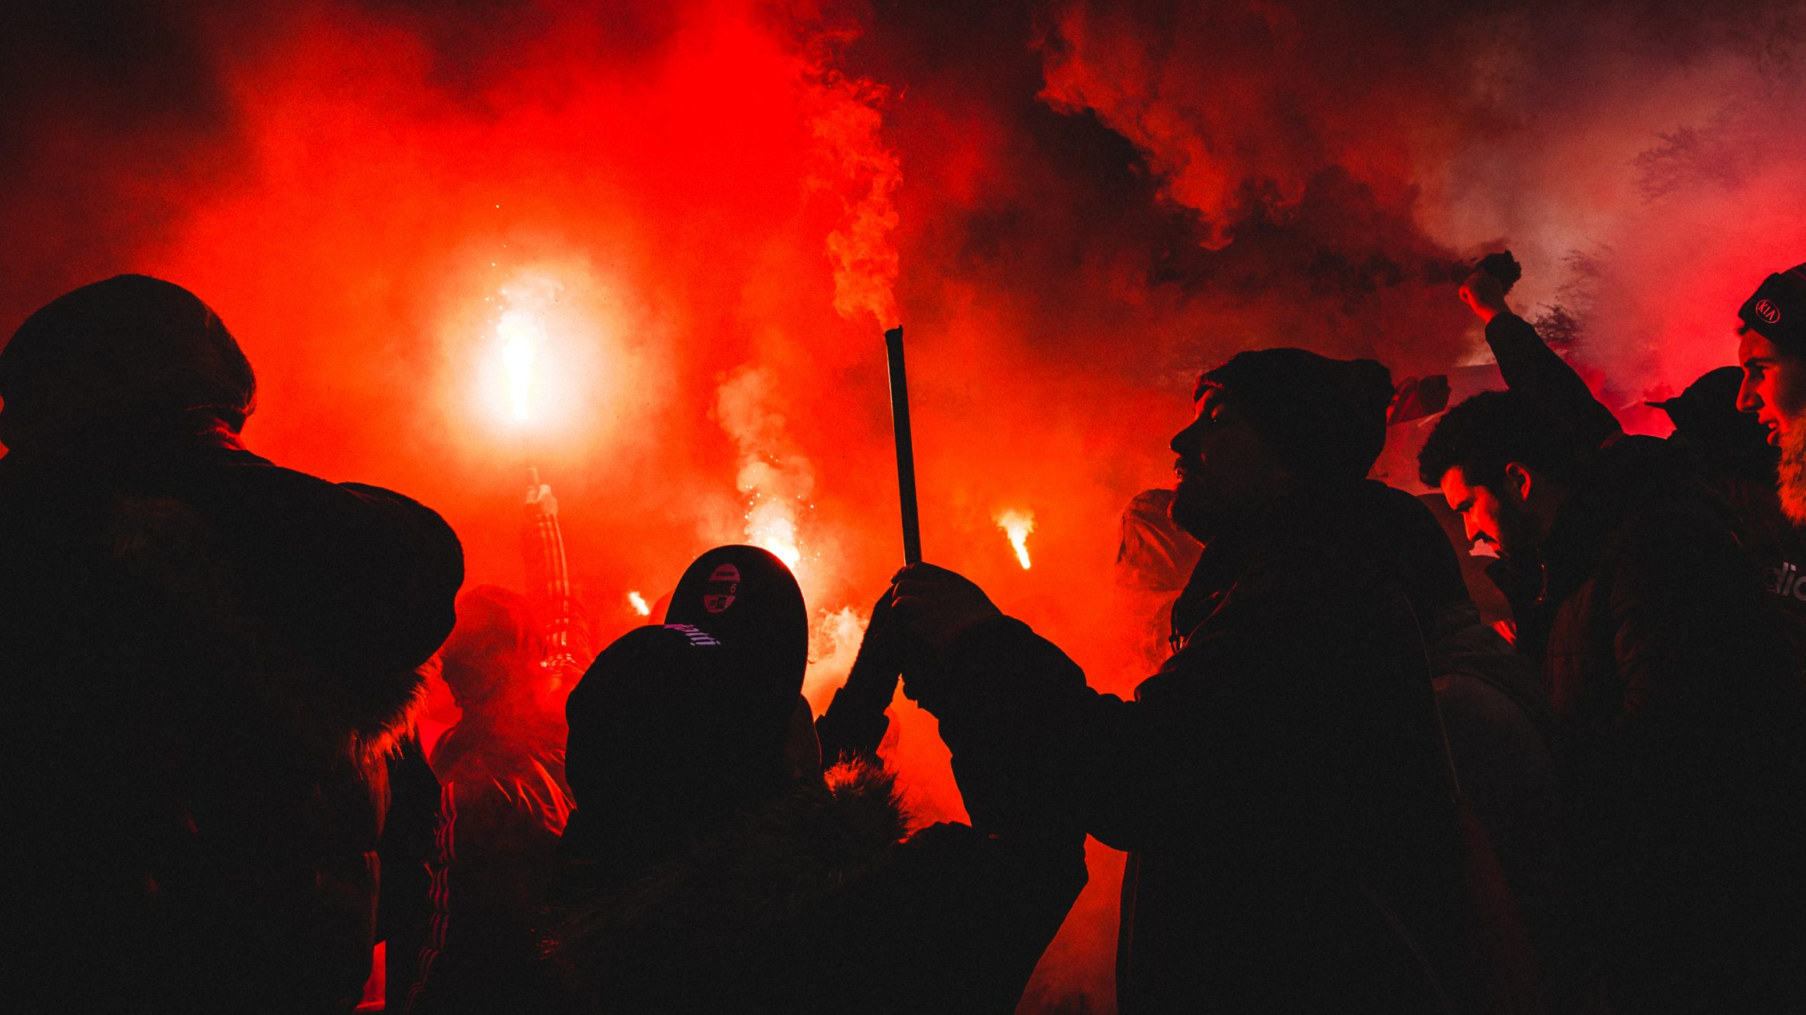
RECAP
Went through certain Social Media Analyzing tools like Buffer, Hoot suite, Google Analytics, Sprout Social and so on.
Also found that Sprout Social were ideal for taking better data driven decisions, thus by we can ensure strong stakeholder engagement.

Slide 6
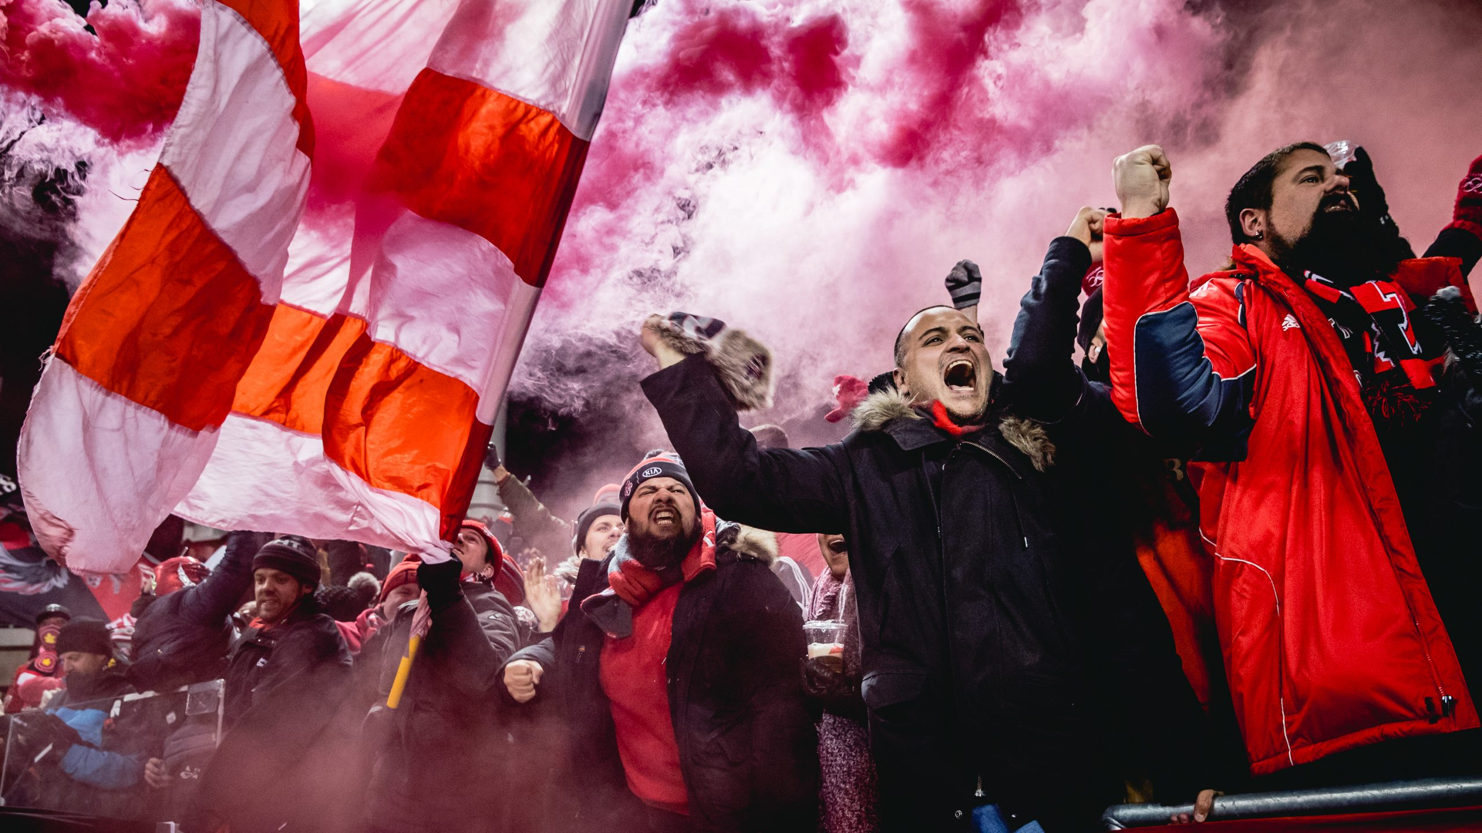
OBJECTIVE
The team is divided into two subgroups: one responsible for creating visualizations and analyzing data on fan behavior, and the other for interpreting findings for stakeholders. They want to increase Toronto FC fan involvement together.

Slide 7
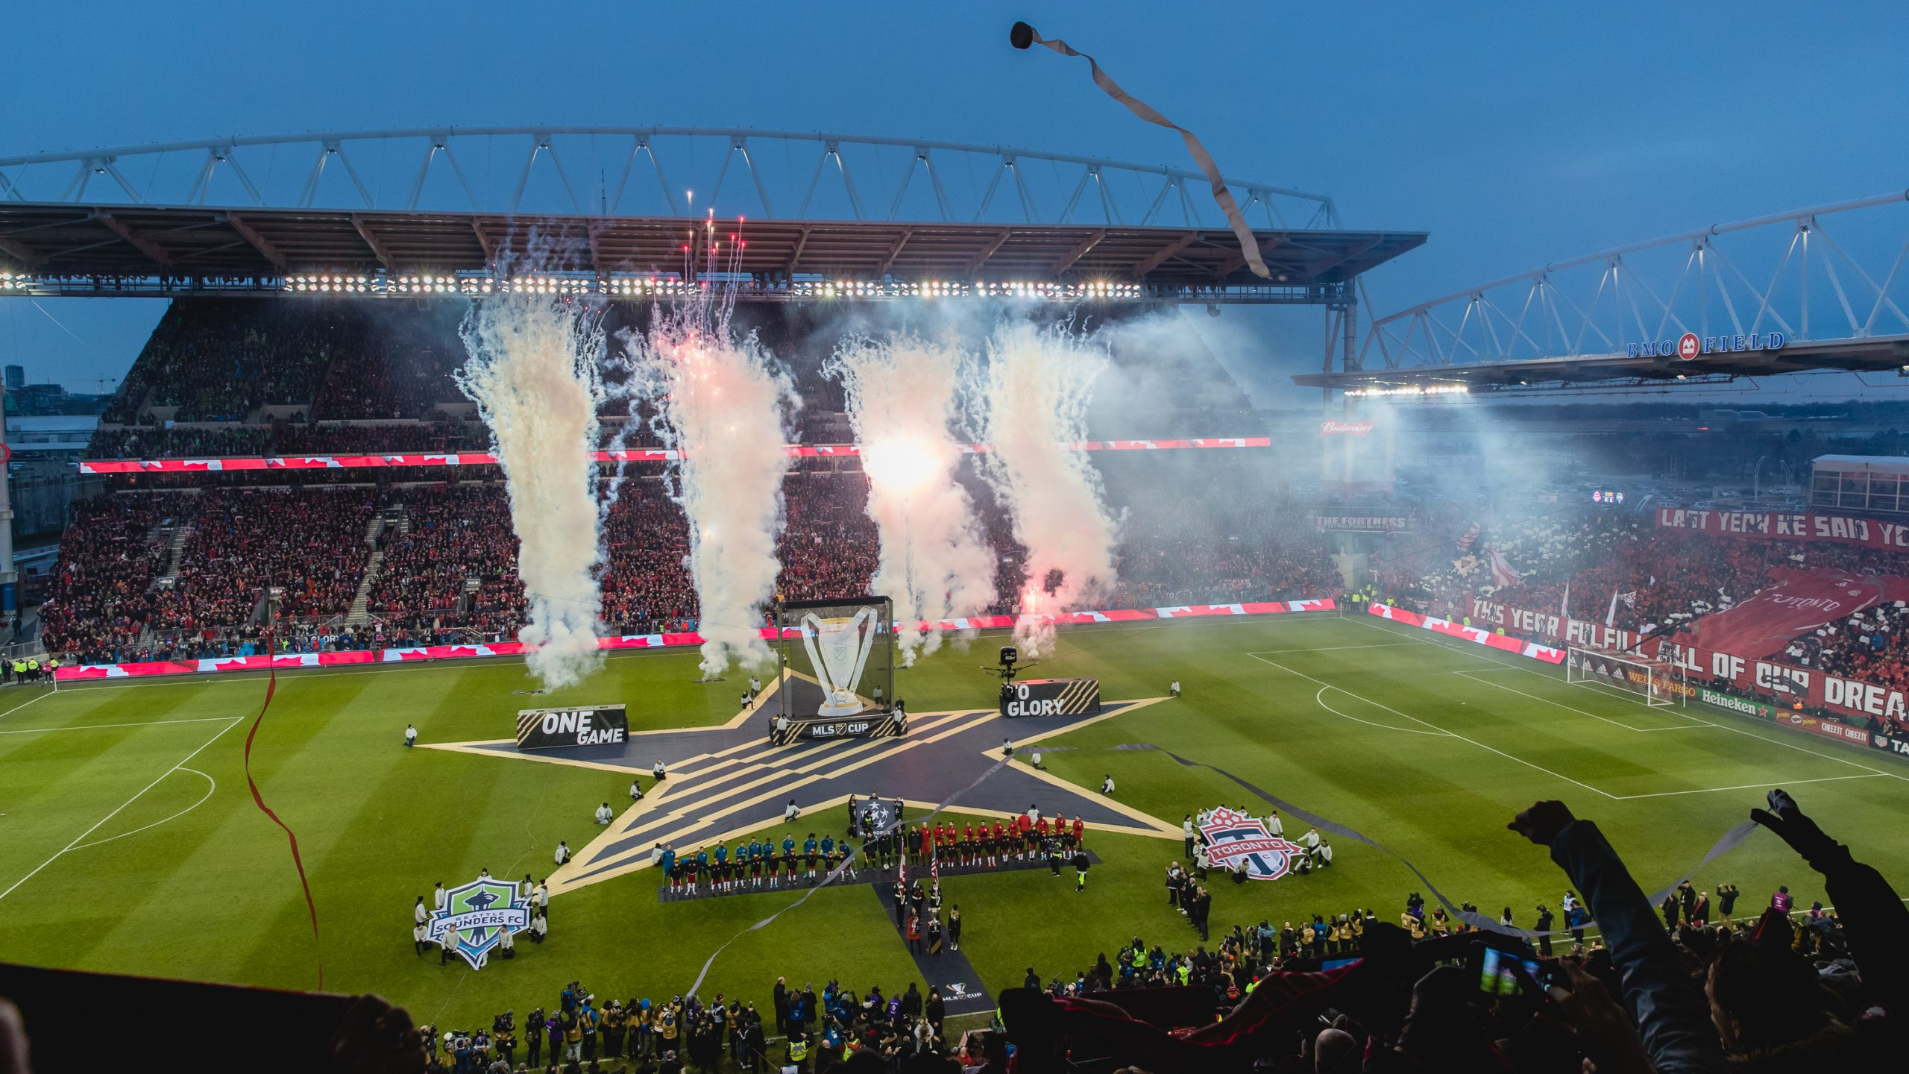
TEAM STRUCTURE & ROLES
SUB-GROUP 1
Venkata Manish & Mohamed Afthab
Examining relationships between attendance and game performance and producing beautiful data visualizations.
SUB-GROUP 2
Chibuike Okoroama & Prescila Mora
Interprets visuals, extracting important insights to communicate successfully with stakeholders and business professionals.

Slide 8
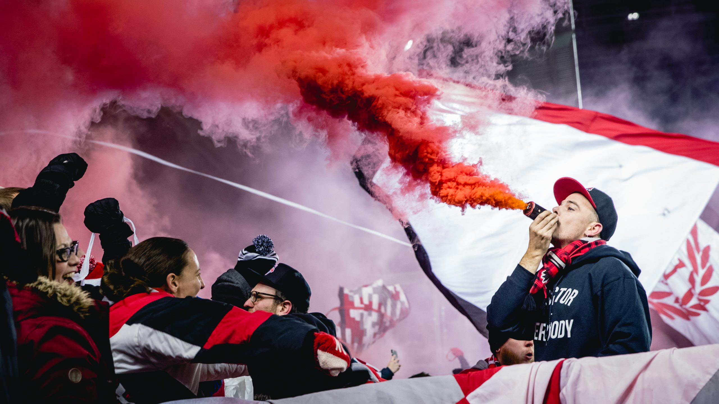
DATA ANALYSIS
DATA POINTS
Opponent
Attendance
Weather conditions
Game Day
Score (Home)
Stadium
Fan Engagement Metric
Game Time
Stadium Capacity
Rivalry Game
Ticket Price
Score (Opponent)
10000 + entries
12 variables
1048.8 KB Memory
Datatypes: : float / integer / object

Slide 9
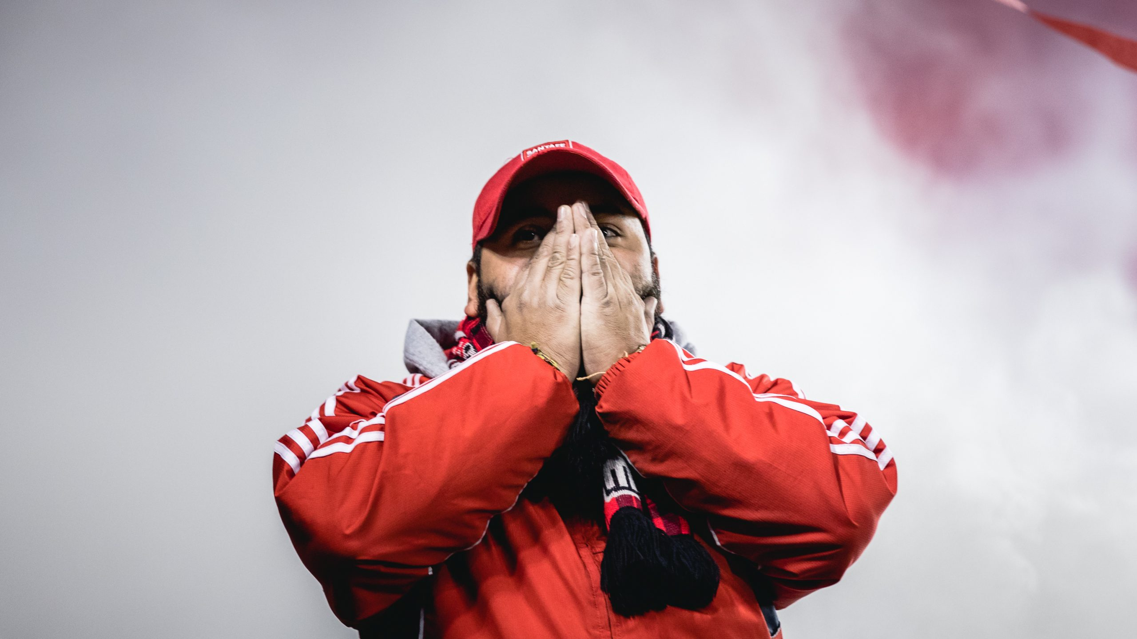
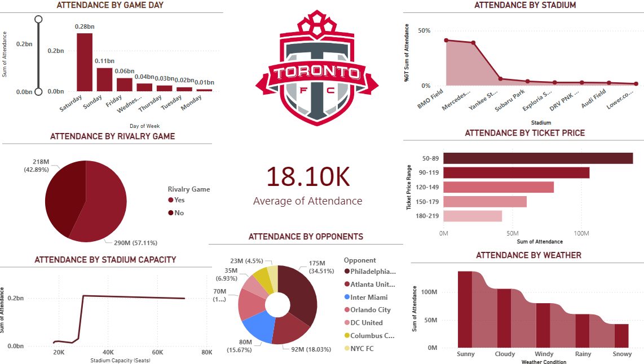
VISUALIZATION

Slide 10
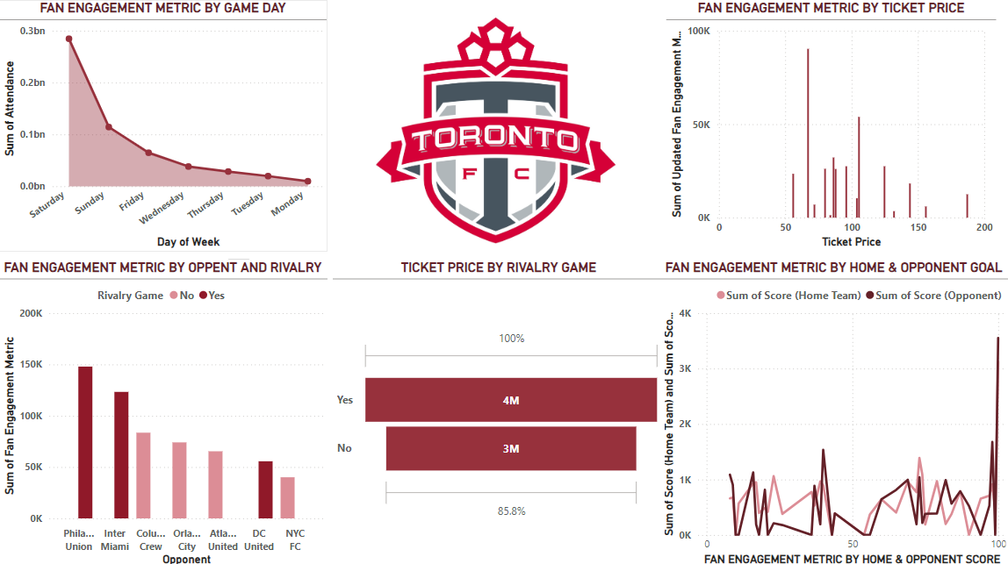

Slide 11
INSIGHTS
People tends to choose weekends and Fridays rather than other days.
Attendance is more in rivalry games.
As the stadium capacity increases, attendance also increases.
Ticket purchase is more during sunny and least at snowy weather.
Fan Engagement Metric is higher on weekends.
Fan Engagement also depends on previous game performance of both teams.
Average attendance is 18.10K per match.
People shows equal interest in games both at day and night.
Ticket price for rivalry match is more when compared to others.

Slide 12
STRATEGIES FOR STAKE HOLDER
Schedule important matches and promotions over the weekends to increase attendance and fan involvement.
Make special offers for rivalry games to take advantage of the increased interest.
Provide more affordable tickets and do some promotions particularly for non-rivalry games, to keep attendance high.
When the weather is bad, use discounts and inside activities to boost attendance.
To increase attendance during the colder months, provide warm rooms, indoor activities, or discounts.

Slide 13
REFERENCE
MLS Official - https://www.mlssoccer.com/stats/
Toronto FC Official - https://www.torontofc.ca/
Whoscored - https://www.whoscored.com/
ESPN Soccer - https://www.espn.com/soccer/
Footystats - https://footystats.org/
FBref - https://fbref.com/en/
Statbunker - http://www.statbunker.com/
SproutSocial - https://sproutsocial.com/
Hootsuite - https://hootsuite.com/

Slide 14
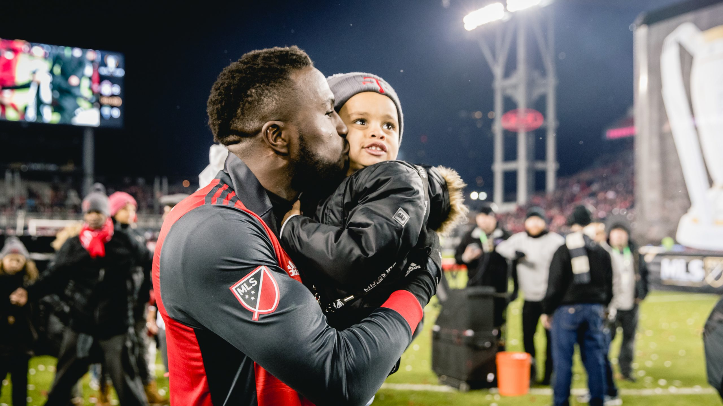
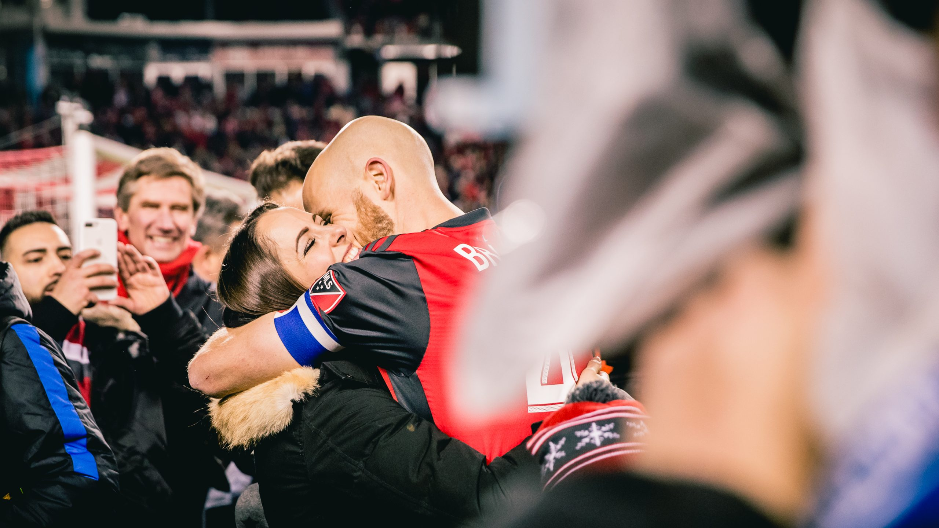
THANK YOU

